Slide 1


AI Readiness
Assessment Proposal
Preliminary Draft: Oct 6, 2025

Slide 2


RBC CDN Banking wants to maximize successful adoption of AI Workforce Enablement
AI Adoption is A key Imperative for RBC CDN Banking IT Group
RBC is ranked #1 in Canada and #3 globally among 50 global banks in 2025
RBC is building a serious AI foundation – from research (Borealis), infrastructure (Lumina, ATOM) to customer facing (NOMI, Aiden) to internal learning (AI Academy.
RBC is increasingly positioning AI as a core enabler of its growth strategy, and is moving forward with increasing it’s AI footprint across the organizations
CDN IT leadership have seen the potential of delivering through disciplined human/AI pairing firsthand through Electric Mind’s workshops
CDN Tech wants to increase productivity through adoption of AI Workforce Enablement across their organization
Our Proposal
Electric Mind is pleased to offer a 10 week fixed price engagement for $300,000.
Scope is comprehensive and will examine people, process, technology and tools from project and change inception through delivery to production.
Our engagement will produce three outcomes:
Current State Summary & Scorecard, including a rigorous maturity assessment.
Target State Definition & Gap Analysis across people, process and technology.
Prioritized Implementation Roadmap, including identification of any “quick wins”.
RBC CDN Banking has asked Electric Mind to review AI adoption readiness and develop an actionable roadmap
RBC is excited by the opportunities, but is concerned with the risk
Electric Mind is uniquely positioned to deliver a strategy that builds trust, grows talent, and embeds AI safely and sustainably
Something something dark side EM is awesome
Slop — lazy use of AI makes undisciplined practices worse, poorly monitored use can result in catastrophic error
Dysfunction — AI amplifies a broken system to be worse, faster
Morale — If AI is seen to replace people adoption will stall
Fit — big bang, one size fits all limits value and confuses teams
Bias - AI may internalize, then scale your worst assumptions
Intentional AI Delivery will be the core, informed by our leading-edge AI pairing experience and decades of modern methods delivery
Simplicity will guide us, benefiting from our experience in better ways of working.
Mentorship our passion for levelling up your people will set the tone
Contextual the strategy will promote incremental change, pairing at all levels
Industry our intimate understanding of Canada’s FIs include countermeasures meant to protect against AI induced error and bias
We are embedded in industry. We are active service providers to most of Canada’s financial institutions, with intimate understanding of operating best practice and expectations for the industry.
Electric Mind can help RBC move from vision to execution readiness while avoiding costly missteps

Slide 3
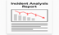
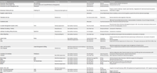
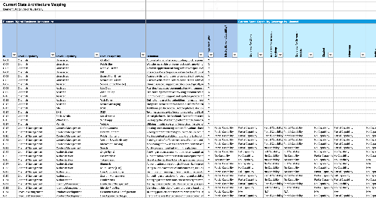
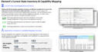
Electric Mind proposes a strategy that will bring Clarity, Direction, Momentum to your AI enablement journey
The 12-week engagement will produce four distinct deliverables which will enhance understanding, and position the organization to accelerate AI adoption and integration for productivity benefits.
Detailed Assessment Report
Target State
Roadmap
Executive Summary
Insights into the current state AI workforce readiness
People, Process and Technology target
The step we take toward transform to AI workforce readiness
A concise summary of key findings, recommendations, and the finalized target state with next steps for stakeholder approval.
Comprehensive Maturity Assessment
Objectives and Outcomes
Systemic Barriers to Adoption
Culture and Capability Gaps
Key Risk Assessment
Change Readiness Analysis
Vision and Principles
Target Operating Model
Technology Options / Impact
Governance and Risk Approach
AI Enablement / COE Services
Adoption Approach
Success metrics
Incremental Adoption Plan
Pilots / Quick Wins
Enablement / COE Plan
Technology Implementation Plan
Skills development plan
Change enablement plan
Quarterly Outcomes and Key Results
ROI based prioritization and sequencing
Key findings and recommendations
Current State Maturity Level and key gaps
Prioritized productivity opportunities with ROI estimates
High-level transformation roadmap with resource requirements

Slide 4
Our Approach
Phase 1: Strategic Alignment and Current State Discovery
Phase 2: Organizational Maturity Evaluation
Phase 3: Productivity Opportunity Identification
Phase 4: Strategy Development
and Roadmap
Key Activities:
Conduct executive stakeholder interviews
Deploy workforce surveys and focus groups to assess change readiness, skills gaps and cultural barriers to AI adoption
Outcomes:
Clear understanding of leaders' vision and strategic alignment between AI initiatives and business objectives
Baseline assessment of workforce readiness
Initial AI maturity scores
Visibility into key areas for further evaluation
Key Activities:
Complete comprehensive AI maturity
Conduct value stream mapping and flow and friction analysis of E2E workflows
Analyze technical infrastructure, data arch., and AI integration capabilities
Outcomes:
Comprehensive AI maturity scorecard with gap analysis and benchmark against industry peers
Complete value stream maps highlighting productivity improvement opportunities
Technical Readiness assessment for AI
Key Activities:
Facilitate workshops to identify and prioritize high-impact AI use cases
Develop ROI calculations for top productivity opportunities and prioritize for quick wins and strategic opportunities
Conduct skills and role impact analysis of current positions vs. future AI-augmented roles
Outcomes:
Prioritized portfolio of 8-12 AI use cases with detailed business case & ROI projections
Strategic opportunity roadmap
Key Activities:
Synthesize assessment findings into an AI workforce productivity strategy
Develop 24 month transformation roadmap
Design change management and capability development plans
Outcomes:
Complete AI workforce productivity strategy
Detailed implementation roadmap
Integrated change management plan
Week 1
Week 2
Week 3
Week 4
Week 5
Week 6
Week 7
Week 8
Week 9
Week 10
Week 11+
Program Kickoff
Artifact collection and analysis
Action roadmap based on priorities
Conduct SME interviews
Update based on the plan
Confirm baseline & score carding
Scorecard
Draft
Identify and socialize targeted quick wins
Remediation Plan Draft
Refine delivery controls and gating
Define target state delivery framework
Stakeholder signoff
Develop future roadmap
Align Stakeholders
Legend
Status meeting
Governance meeting
Phase Milestone

Slide 5
Electric Mind’s Perspective on AI Workforce Enablement

Slide 6
From 2020-2025, the AI Maturity Landscape has dramatically shifted, with substantial acceleration towards transformation.
2020
2025
Most organizations have operational experience with AI, though true end-to-end transformation is rare.
52%
35%
27%
20%
25%
14%
10%
10%
5%
2%
Stage 1
Stage 2
Stage 3
Stage 4
Stage 5
Exploring
Experimenting
Formalizing
Optimizing
Transforming
Exploring what AI is and what is can bring to your org.
Experimenting with POCs and pilots.
Moving from POCs/Pilots to AI solutions in production.
Scaling AI solution deployments.
Transforming the organization through the use of AI.
Notes:
Paradigms
Situating the maturity stages
Past 5 years
Moving from experimental, operational, transformational
-- Source element AI

Slide 7




AI has significant Implications across the Technology Delivery lifecycle
AI IS TRANSFORMING THE WAY WE WORK
We are now entering an “everyone is a builder” economy. New apps can launch in days—not months or years. Business agility no longer needs to be crippled by specialist silos or brittle handoffs
AI enables speed without compromising safety or governance
COMPETING IN THE AI ERA REQUIRES A MINDSET SHIFT
IT Management’s job will change toward providing teams with context, not with control. Real gains in IT delivery will require moving beyond today’s highly functionalized organization. Critical thinking, bus/tech fluency, and adaptability will be required across entire the IT workforce.
Winning with AI means shifting from managing our work to accelerating our thinking.
AI ADOPTION BRINGS REAL RISK
Papering over organizational dysfunction with AI will multiply that dysfunction. AI requires clean, well-maintained digital artifact, an end to poor practice /poor hygiene. Tooling must integrate seamlessly with AI while remaining fit for purpose. Culture will fight back - leading requires a fundamentally different approach to change.
The real risk with AI isn’t the tech— it’s carrying yesterday’s habits into tomorrow’s tools
LEARN FROM AGILE—BUT DON’T REPEAT ITS MISTAKES
Agile is both a cautionary tale, and catalyst for further change, acting as a launchpad for AI-augmented work. Centralize strategy: vision, principles, incentives, and building enablers. Execute change locally with sustainable, incremental change. Be inspidintg in vision bit pragmatic in execution; above all avoid another big bang change.
Real change happens in steps - pacing and learning matter more than planning

Slide 8



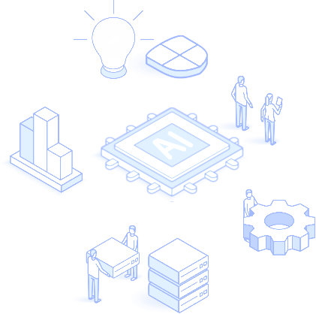



AI-driven mindset, practice, and tools will accelerate the entire delivery lifecycle
Opportunity Refinement
AI brings business context to IT quickly – clarifying the problem, sizing the effort, and surfacing the value.
Stakeholder goals, risk signals, IT capability, are used to generate business cases, roadmaps, and credible delivery plans in hours
Accelerate alignment between IT and business partners
Validation
AI helps measure real-world impact - correlating user behavior and adoption to outcomes. Signals are tied back to hypotheses, enabling rapid learning and course correction, closing the gap between delivery and value.
Business and IT learn faster what’s working, —and what matters.
Scoping and Planning
AI listens to team conversations & workshops -artifacts are generated that align outcomes to scope & acceptance
AI helps extracts key decisions, drafts stories, define specs, and refine acceptance criteria
Handoffs across business and IT are faster & cleaner
Production
Integrated AI / CICD tooling predicts and even remediates deployment issues, and optimises release windows
AI monitors and detect anomalies, suggest optimizations, and even generate fixes.
Go lives are faster, more frequent and more reliable.
Engineering
AI brings context necessary to align needs to current systems and target architecture
Developer supervised agents generate well crafted code, accelerate integration, and ease system migration
Productivity and throughput increase, boilerplate work and design drift are eliminated.
Testing
AI auto-generates unit tests, integration contracts, edge cases, and test templates.
Test scaffolds are created in parallel with stories, shortening feedback loops and increasing test coverage. Human QA reviews, tunes and finalizes.
Testing is done earlier, deeper, and more frequently

Slide 9




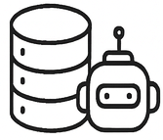

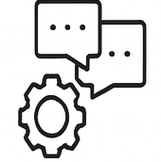

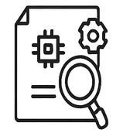
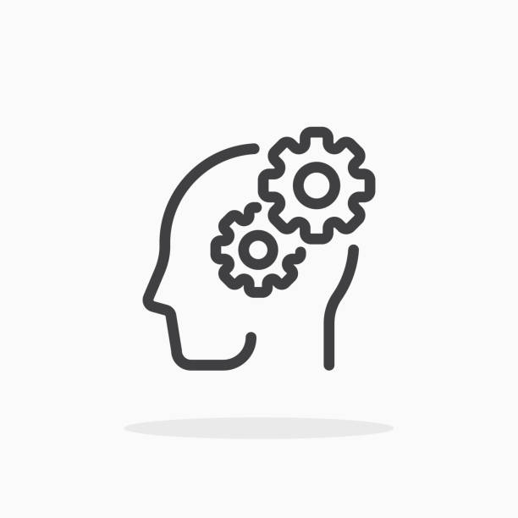
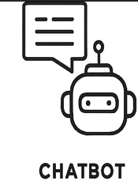


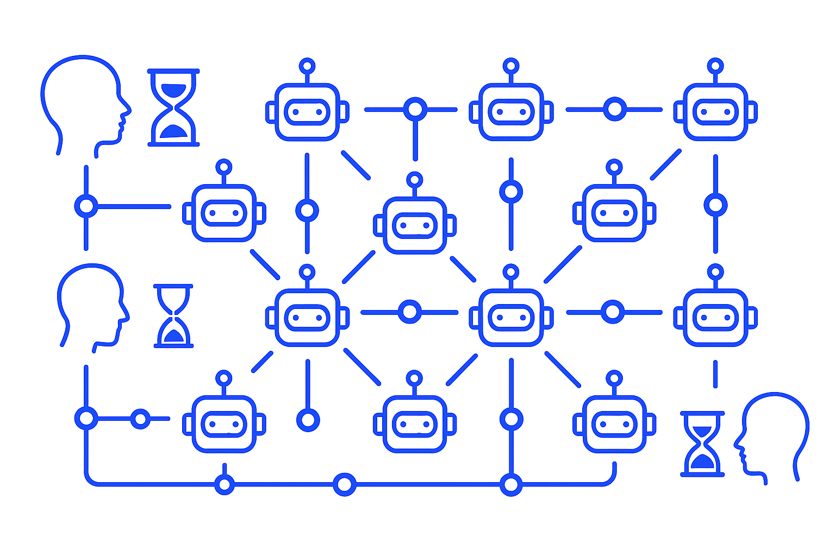
Change Strategy
Enablement
Assess the system for high-leverage failure points. Introduce consumer-level AI and light workflow tweaks to maximize impact. Give your workforce superpowers.
Expand the case for change…
Ownership Channel early success to spark ownership. People tune, feed, and steward their own agents. AI boosts leader’s ability to provide their context at larger scale, share their knowledge, and raise standards.
Bring specialized context to the frontline increasing relevance, awareness, and alignment
Orchestration Momentum fuels broader alignment towards a simplification and more holistic improvement. Leaders, while remaining in charge - are responsible for amplifying their presence through a network of agent
Connect the enterprise, helping people act with purpose, and connect strategy to execution
Navigation
Success is about aiming human-in-the-loop effort where it matters most — critical judgment, values, and edge decisions.
Enable Humans to focus on values and judgment.

Slide 10
We will start by assessing your AI Workforce Readiness across these Key Dimensions
We will assess the bank's Canadian retail business across six critical dimensions of organizational readiness for AI workforce productivity improvement, enabling the creation of a comprehensive strategy.
What are the dimensions of a strategy to realize an "AI-Ready" organization?
Purpose and Strategy Alignment
Process and Workflow Re-design
Capability Development
Management systems and leadership behaviours
Mindset and cultural transformation
Measurement and continuous improvement
Strategic Alignment & Leadership
Operating Model Orientation
Data & Technology Infrastructure
Clear, value-linked AI agenda with executive ownership and funding; explicitly tied to priority outcomes.
Elements: Value thesis and prioritization, Leadership roles and Decision rights, Funding & partner strategy.
The org designs AI into how work gets done. End-to-end teaming is the default delivery model.
Elements: Value stream & Journey Analysis, E2E Teaming structures, Human-in-the loop controls, MLOps.
Trusted, accessible data and secure platforms support safe and reliable AI use at scale.
Elements: Data Foundation & Access, AI Platform & Integration Fabric, Observability & Trust.
Talent & Skills Readiness
Governance, Risk & Ethics
Culture & Change Management
The workforce is equipped to productively use AI, with roles and teaming patterns to unlock productivity.
Elements: Role-Based AI Fluency, New Roles & Teaming, Adoption Support & Enablement.
Policies and controls make AI safe, compliant and explainable, while enabling experimentation and learning.
Elements: Responsible AI Policy and Standards. Security and Privacy. Validation, monitoring and de-risking approaches, team-by-team enablement.
A culture that readily accepts AI-driven change. Leaders and teams are continuously learning and improving.
Elements: Presence of a trust narrative &
a human-focused AI adoption narrative. New ways of working with AI change playbook. Continuous improvement loops.
What does a "ready" organization look like?
Technical Infrastructure
robust data architecture
Modular AI platforms
Human in the loop systems
Organizational Capabilities
Cross-functional teaming
End-to-end teaming readiness (experience with this)
Change management excellence
Service Design
Learning culture
Service Design
Customer intimacy
Leadership and Governance
Strategic alignment
Ethical frameworks
Investment in people
Reinvention readiness
Notes:
Types of productivity improvements
Task automation
Accelerated decision making
Improved workflows
Quality improvements
Productivity levers
Skill amplification
System-level innovation

Slide 11
Next: Align on principles that ground a fundamental re-think of our organizational operating system
As organizations adopt and integrate AI, they need to customize and align on the principles will acts as a True North for their change efforts
Organize around Outcome Oriented Teams
The core building block for AI-driven agility
Hierarchical structures and functional silos block flow of context
Context preservation enables speed of work and decisions
Outcome oriented teams ensure context-aware accountability, clarity, and rapid opportunity response
Simplify the Way We Work
Prioritize removing friction and delay with AI
if the workflow is dysfunctional, AI will amplify it, reversing capacity gains
eliminate toil, destroy barriers to collaboration, remove bottlenecks, reduce manual control
(Re-)Design for adaptability
Design AI-powered systems that flex to meet diverse user needs and problem domains
Pair modular solutions with modular organizational design to enable rapid reconfiguration while limiting change fatigue
Standardize on interfaces but be tolerant of implementations that emerge bottom up
Champion Humanity and Learning
Deploy AI to leverage and augment human expertise and creativity, key to shifting culture
Focus on human-in-the-loop feedback where humans orchestrate, validate, improve and override
Invest in upskilling talent in meta-skills: judgment, facilitation, systems thinking, AI usage / stewardship.
Foster cultures of experimentation, transparency, and learning, rapid failure adaptation is required
Design for your (unique) Value
Don't just deploy tools because they're available
Center work design around mission, market needs and employee meaning, with AI as a tool to unlock, not dictate, outcomes
Notes:
Comlpiance constraints will make the hybrid operating model difficult

Slide 12


Slide 13
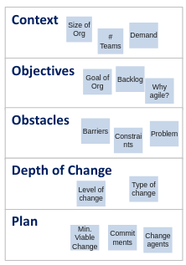
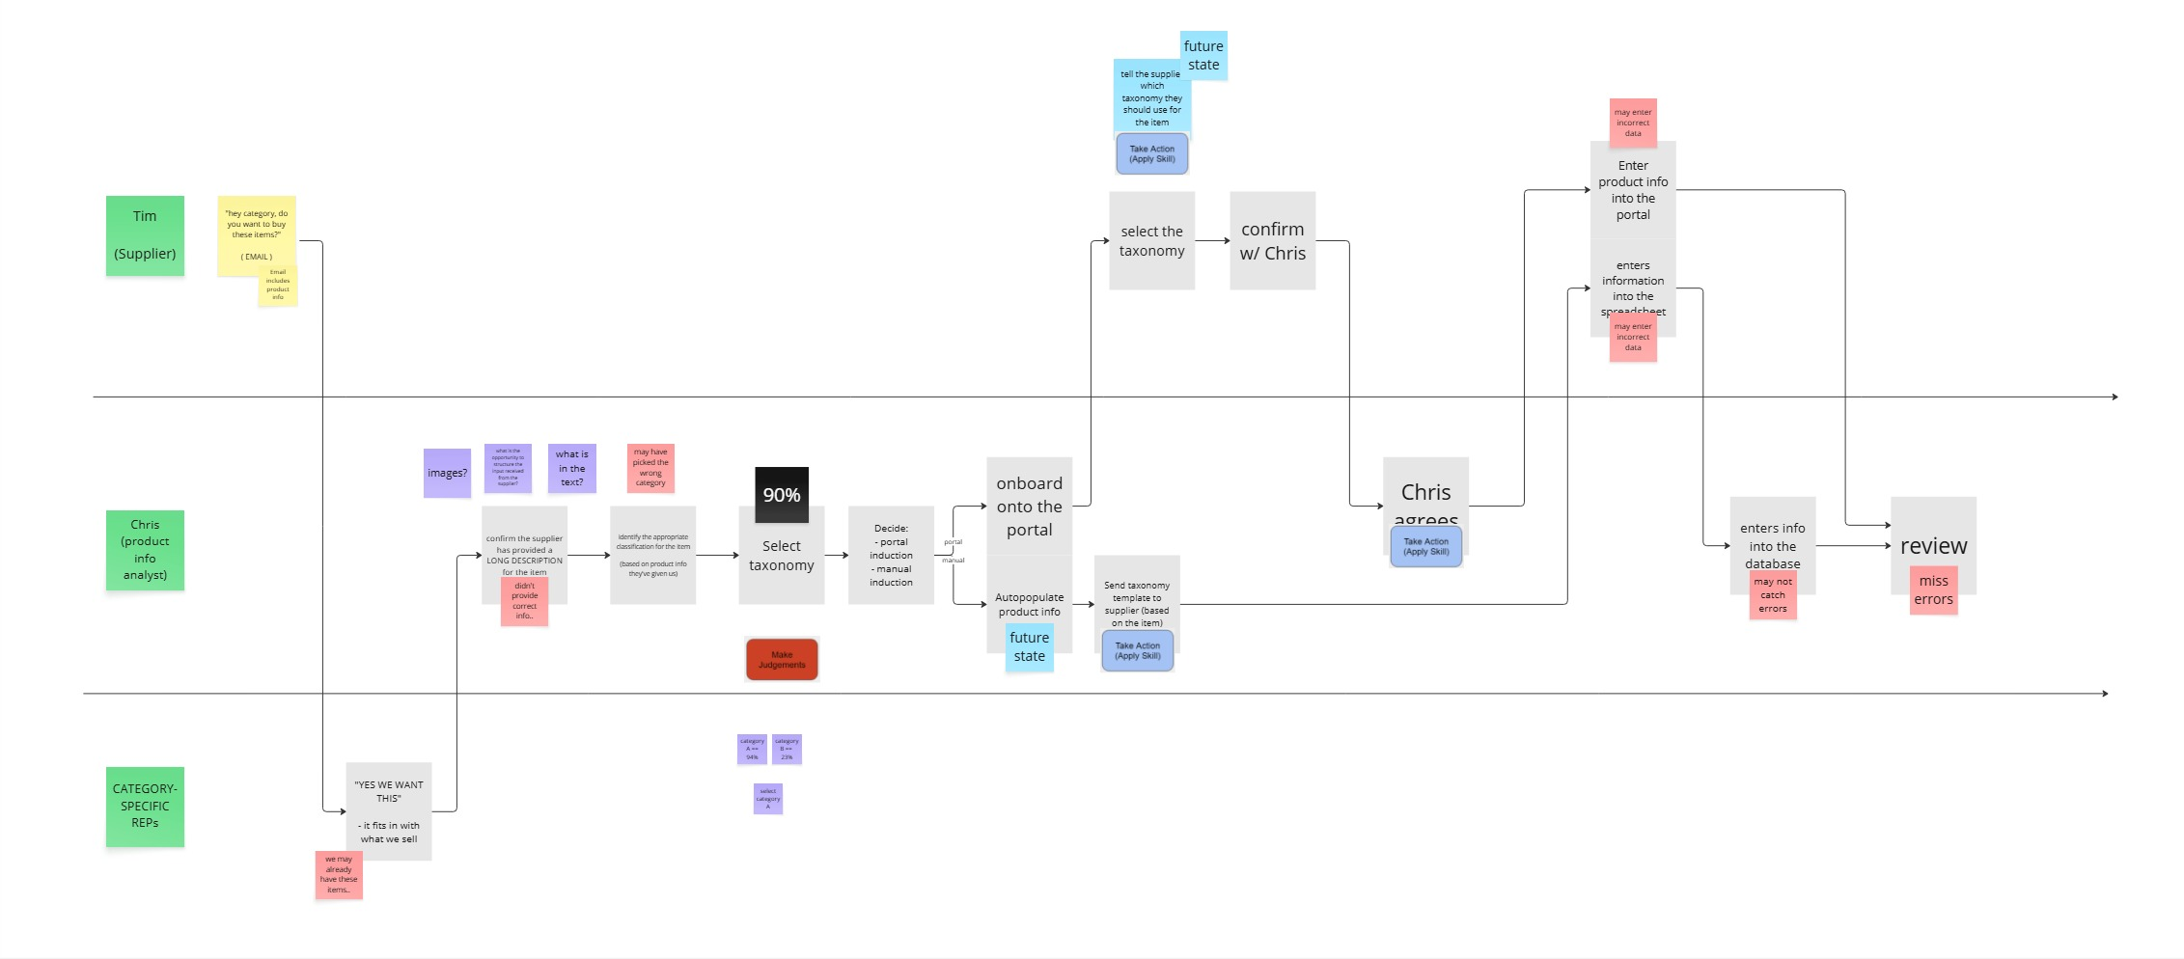
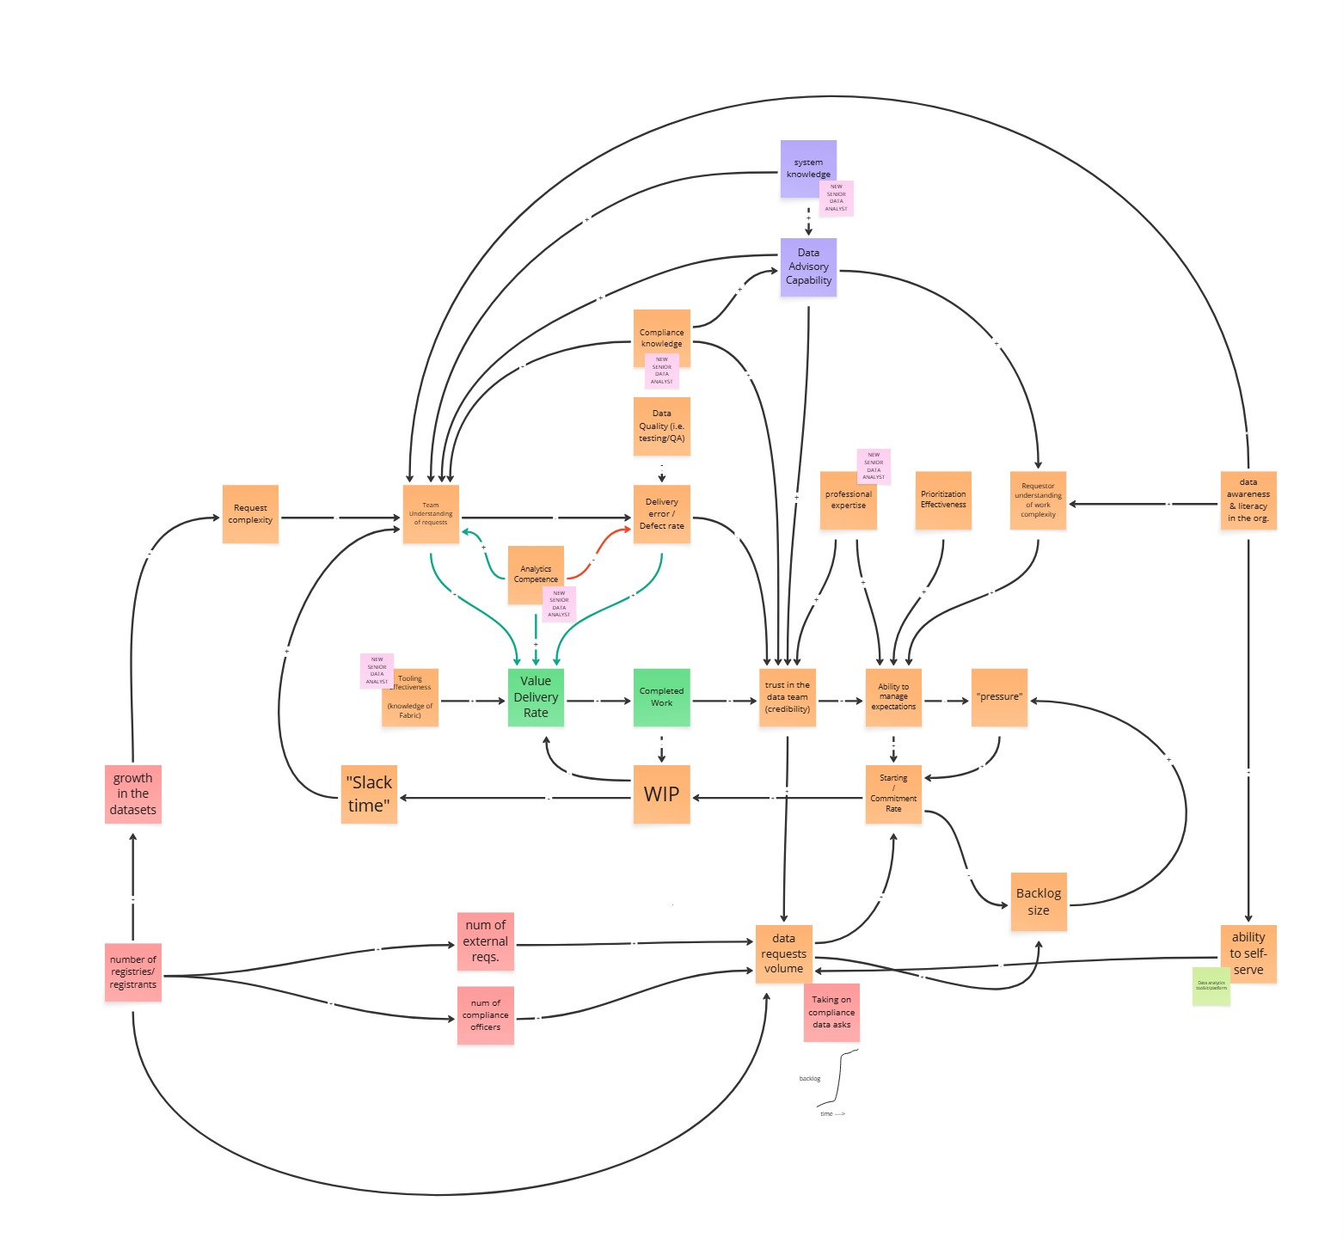
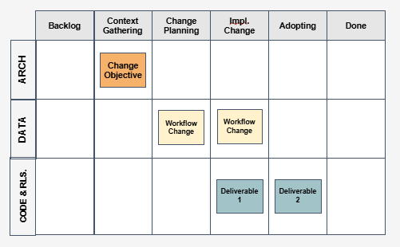
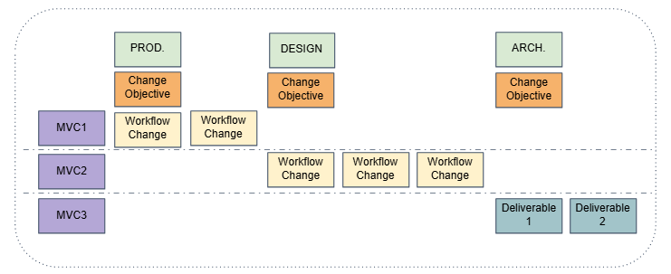
How we aligned our Client toward an AI enabled system of work
3
1
Co-design the change
Gather context
4
2
Visualize and co-deliver change
Map the system
Establish understanding of the domain, its change objectives and its change context
Pair with leads and SMEs & describe how teams collaborate to convert effort into outcomes.
Identify the systematic causes for issues, creating a shared mental model with stakeholders.
Incrementally deliver MVCs in partnership with change agents, visualizing and communicating change progress.
Change Canvas
Outcome-to-work Mapping
Causal Loop Diagram
Change Kanban
Identify areas of opportunity for AI-powered systematic change:
Multiple silos and handoffs
High exception rate
Toilsome and tiresome work
Decisioning delays & bottlenecks
Collaborative friction
Context fragmentation​
Partner with change adoptees to ideate, design, prioritize and sequence a backlog of Minimum Viable Changes (MVCs).
Transparently verify and validate the results of change, measuring (at a minimum):
System Effectiveness (Outcomes/Inputs)
Lead time vs. baseline
Throughput vs. baseline
Toil Reduction & change fitness

Slide 14

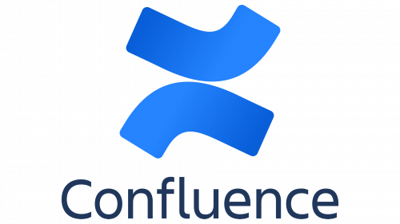


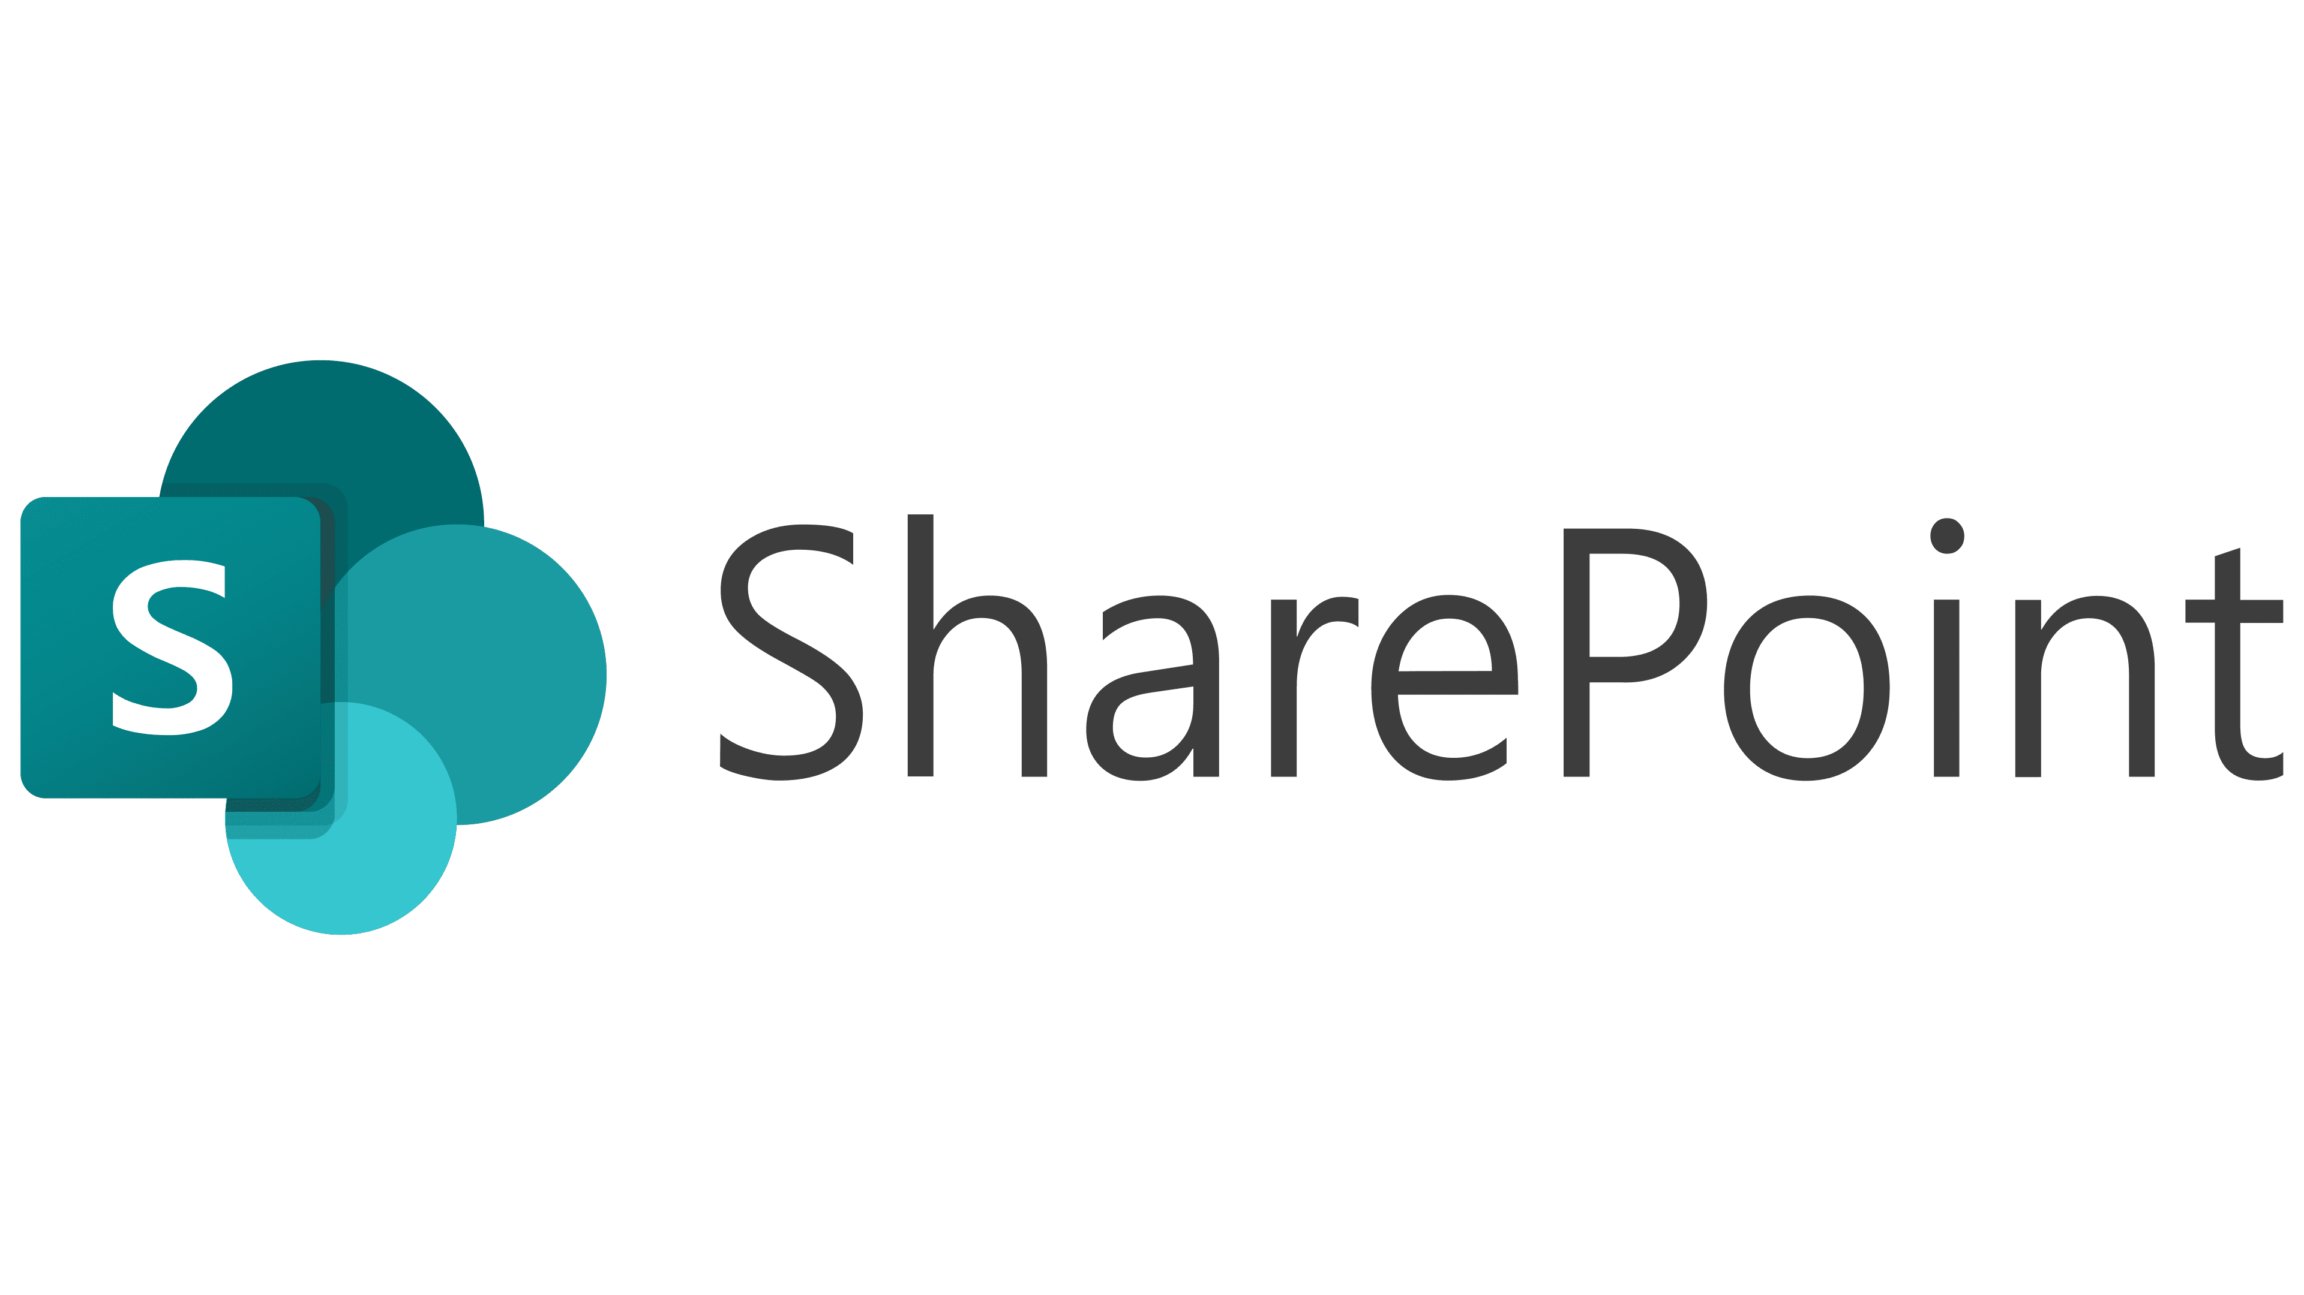


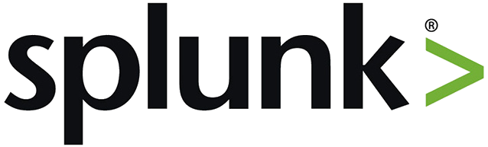
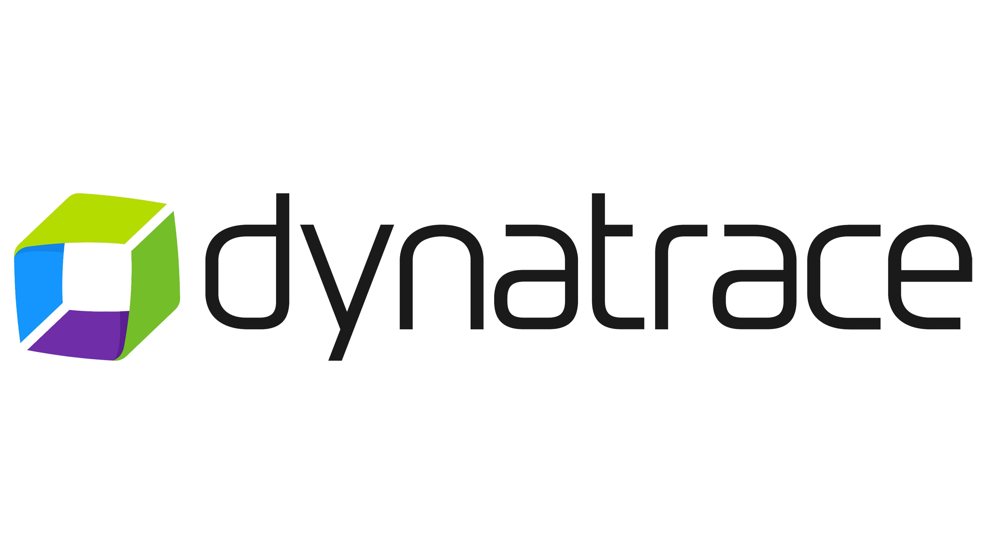


Asynchronous Artifact Collection and Analysis
Add on based on what we would need
To meet the aggressive assessment timelines, we require access to as many of these artifacts as exist within the first few days of the engagement to aid in our assessment.
Given the broad nature of the data requests, Electric Mind requires a Project Coordinator to facilitate access requests on behalf of the team.
PROGRAM DESIGN & STANDARDS
Technology org charts
Program and project list
Delivery methodology & standards documentation
Process list or inventory if it exists
Templates related to change and release management
Incident and problem management documentation
REQUIREMENTS & DESIGN
Requirements/backlog exports (Jira), incl. statuses & owners
Traceability matrix (requirements <> test cases <> releases/features)
Architecture/design sign-off templates and recent approvals
UX/UI standards, design system, and validation/usability reports
Security & privacy requirements embedded in design (threat models, PCI, PII, etc.)
SDLC & CODE REVIEWS
Documented SDLC workflows and RACI (per product/program)
Branching strategy and repo policies (GitFlow/trunk-based)
Pull request/review logs and coverage ratios
Static analysis and lint reports (tool outputs & gating thresholds)
Developer onboarding guidelines and coding standards
ENTERPRISE & TESTING GATING
Enterprise stage-gate checklists, sign-offs, and governance calendar
Test strategy & plans (unit, API, integration, regression, non-functional)
Automation coverage reports (by service/module) and pass/fail history
Environment readiness runbooks and data management procedures
Defect triage board exports, severity SLAs, and aging metrics
DEPLOYMENT & OPERATIONS
CI/CD pipeline definitions and promotion rules (with approval gates)
Release readiness and cutover sign-offs; rollback/canary/blue-green plans
Monitoring/observability dashboards and alert rules
Incident post-mortems / RCAs (recent 6–12 months)
SLA/SLO/SLI reports (uptime, latency, error budgets) and capacity planning
CONTINUOUS IMPROVEMENT
Retrospectives/post-mortems with tracked action items
Delivery metrics: throughput, velocity, defect escape rate, MTTR, deployment frequency
Audit/compliance artifacts (PCI, PIPEDA, ISO, threat/vuln scans & remediation)
Training/upskilling records relevant to quality practices
Risk register with mitigations and ownership
Incident reports

Slide 15
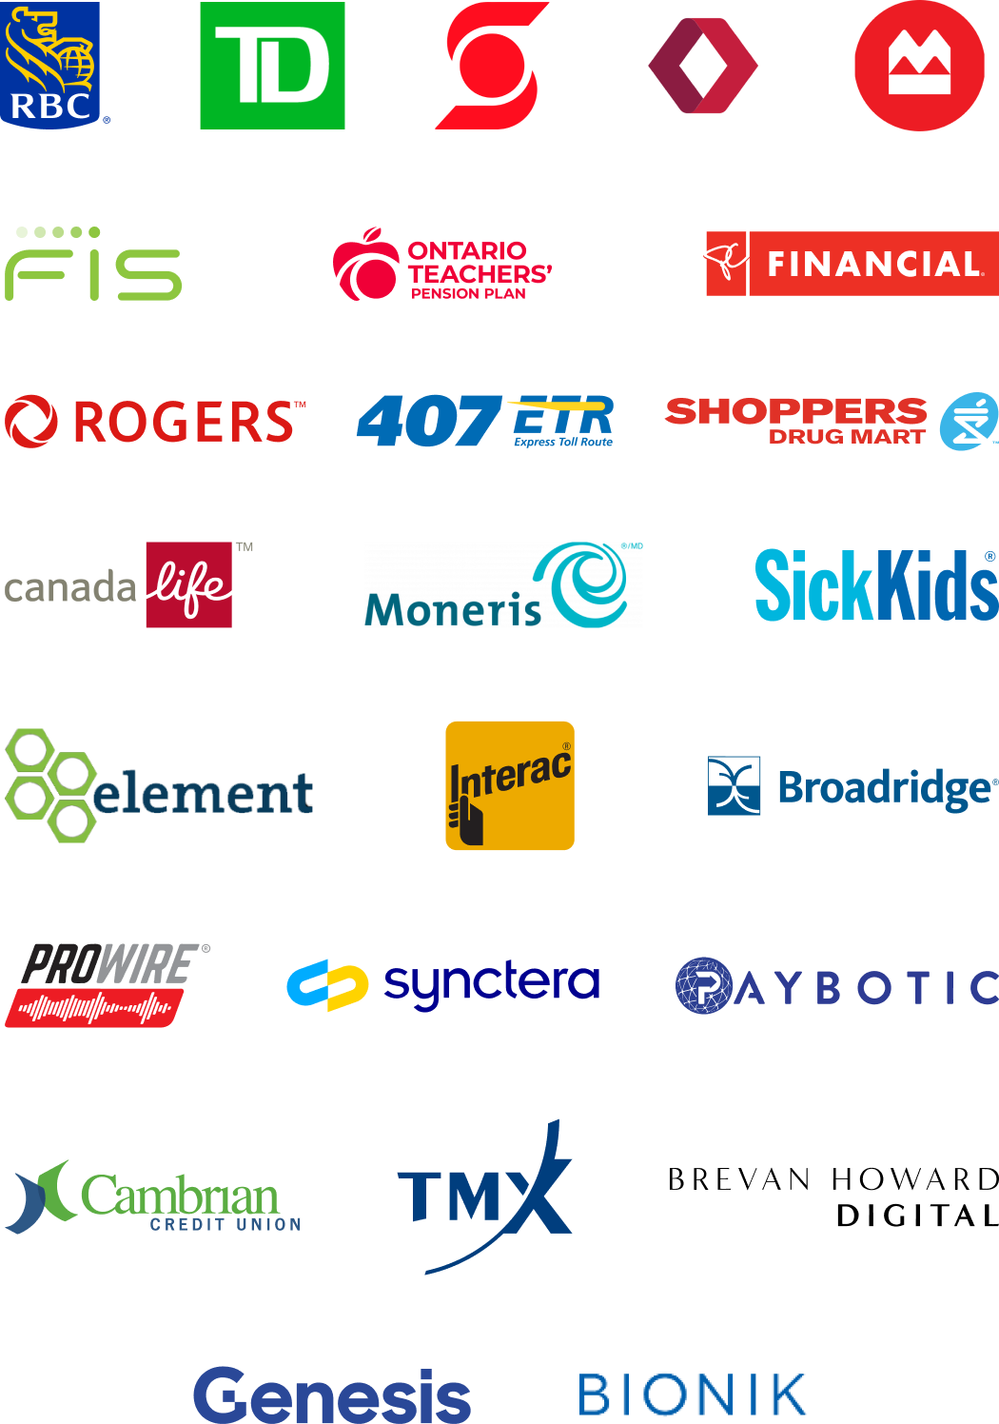

About Electric Mind
35
100+
Electric Mind is a business and technology consulting leader in providing innovative, practical solutions driven by engineering excellence.​ We combine seasoned digital and financial services business and technology domain specialists to deliver substantial value to our client's end-to-end; from strategy through to transformative delivery. We are very proud of our history of serving clients globally and spans a successful 35 years.
Years Experience
Clients
1000+
250+
Projects
Workforce
We are consulting engineers, providing strategy, design and implementation services.
Our advice is based on learned experience delivering critical systems for some of the largest financial institutions in the world.
// Our financial services clients include

Slide 16




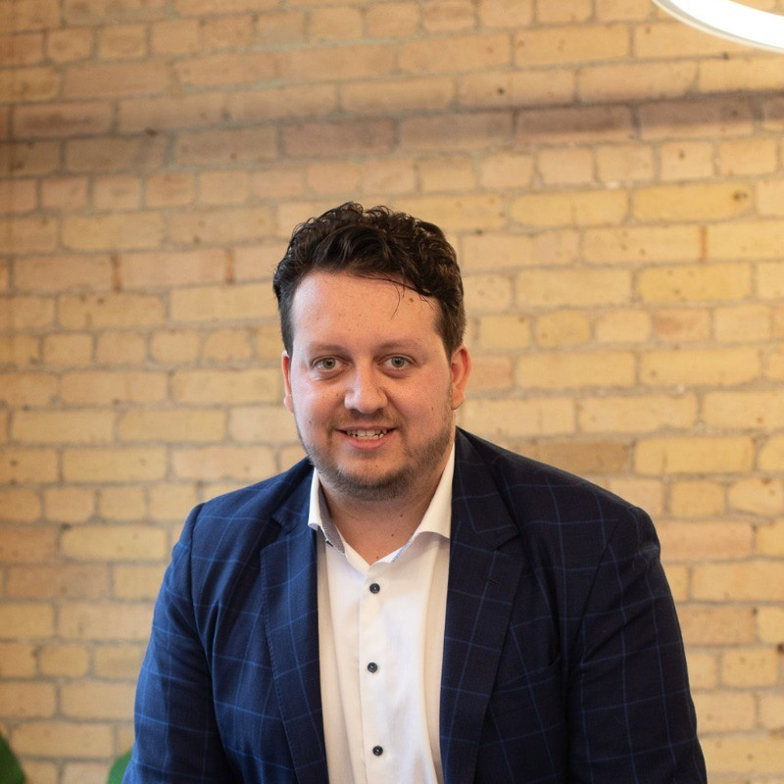
Engagement Team
An experienced team with Advice and Implementation experiencing spanning all aspects of the SDLC
Chris Ford
CEO & MANAGING PARTNER Chris is a senior business executive with over 20 years of market experience, specializing in strategy and implementation of technology transformation services.
Andrew Pitt
CLIENT PARTNER Andrew has 30 years of experience working with many enterprise clients on a wide range of technology projects. He is a seasoned technology executive with expertise in IT strategy, Agile software delivery, and digital transformation.
Nick Dyment
ENGINEERING LEAD
Nick Dyment has been delivering enterprise technical solutions for Canada's largest companies. Recently, he has been focused on Enterprise Architecture and the adoption of AI in the SDLC.
Connor Hallet
INFRASTRUCTURE LEAD
Connor is seasoned in software delivery, with a focus on DevOps, Cloud Architecture, and Platform Engineering. He holds a bachelor’s degree in software engineering and management from McMaster University.

Slide 17



Our other AI Focused Engagement Models
We are flexible in the ways we engage, balancing AI oriented transformation with delivery priorities…
WHOLE SOURCE
AUGMENTATION CO-TEAM
For projects with well defined scope and resourcing constraints, we can provide a complete cross functional team that leverages AI to deliver the entire project more quickly and cost efficiently.
Pros: High focus on value with minimal risk or disruption to ongoing work.
Cons: Minimal impact to workforce adoption of AI.
We can provide specific resources embedded in your existing teams on priority initiatives. Our staff have an AI forward approach which is leveraged for delivery, as well as internal staff skills development.
Pros: Incremental adoption of AI with minimal disruption for the existing workforce.
Cons: AI adoption is throttled down without critical mass on teams.
Projects delivered with a co-team model leverage the relevant skills of our workforce and take advantage of variable capacity to deliver strategic projects quickly with optimal workforce transformation.
Pros: Balance of delivery and coaching delivers maximum value on the project and for the organization.
Cons: Delivery may be faster but still suboptimal in the short term.
Increased Workforce Transformation Potential

Slide 18
Value Creation with Artificial Intelligence
Electric Mind has developed leading edge engagement types that leverage Generative AI.
TYPE 01 /
ACCELERATED BUILD
TYPE 02 /
MODERNIZATION
TYPE 03 /
NON-CODE
TYPE 04 /
AI-ENABLED WORKFORCE
Leveraging Generative AI across the entire SDLC, Electric Mind has demonstrated ability to deliver new applications on greatly accelerated timeframes.
In some domains, custom solution development is challenging the economics of vendor-provided COTS software.
Technology modernization mandates that were previously unaffordable are being unlocked by Generative AI.
AI techniques are very productive in accelerating current state understanding through target state implementation.
Non-code IT delivery artifacts are good candidates for delivery with AI techniques.
Test Case Management for complex platforms is a good example of where Electric Mind is invested.
AI is good at understanding context across artifacts and maintaining lineage.
CIO’s are increasingly tasked with equipping workforce to achieve the productivity benefits of AI.
Electric Mind offers a hands-on leadership workshop that demonstrates AI across the SDLC and considers people and process transformation for CIOs.
25-40% COST REDUCTION to DELIVER
Costs EQUIVALENT TO OR BETTER THAN GLOBAL DELIVERY
IMPROVED QUALITY, CONSISTENCY AND INTEGRITY
Costs EQUIVALENT TO OR BETTER THAN GLOBAL DELIVERY

Slide 19
Delivery Maturity Scorecard
Electric Mind will tailor our standard AI maturity scorecard to align with your tactical and strategic objectives and will provide insights to industry average and market leaders across all dimensions, gleaned through proprietary research and hands-on engagements with all major Canadian FIs.
1. Strategy & Planning
Business goals and outcomes clearly defined and linked to delivery objectives
Clear prioritization of portfolio, programs, and projects
Governance framework established (decision rights, escalation paths, success metrics)
Defined and agreed budget, timelines, and resource allocations
Risk management plan in place (technical, financial, operational)
Alignment with enterprise architecture, security, and compliance standards
2. Requirements & Design
Requirements gathered collaboratively with stakeholders and end users
Requirements are testable, traceable, and mapped to business objectives
Backlog prioritized, refined, and visible (using tools like Jira, Azure DevOps, Rally)
Architecture reviewed and approved (scalability, resilience, maintainability, integration)
UX/UI standards applied and validated with end-user feedback
Security, privacy, and compliance requirements embedded into design
3. Build & Development
Source code under version control with branching strategy enforced (e.g., GitFlow, trunk-based)
Adherence to coding standards and peer code reviews performed
Automated unit tests with defined coverage thresholds (e.g., >80%)
Static code analysis and linting integrated into CI/CD pipeline
Dependencies, libraries, and open-source components tracked and governed
Documentation updated continuously (APIs, architecture, deployment)
4. Testing & Quality Assurance
Shift-left testing practices applied (unit, API, contract tests automated early)
Test environments stable, consistent, and representative of production
Automated regression and integration tests running in CI/CD
Non-functional testing included (performance, load, security, usability, accessibility)
Defect triage process defined with SLA for resolution
Test coverage and quality metrics visible to stakeholders
5. Deployment & Release Management
Automated CI/CD pipelines in place with rollback/blue-green/canary strategies
Release readiness reviews completed (code freeze, approvals, checklists signed off)
Infrastructure as Code (IaC) applied for consistency and repeatability
Monitoring and observability integrated pre-launch (logs, metrics, alerts)
Change management processes aligned with ITIL/organizational standards
Deployment playbooks and runbooks documented
6. Operations & Support
SLAs/SLOs/SLIs defined and tracked for uptime, performance, and reliability
Incident management and root cause analysis process established
Monitoring, alerting, and dashboards reviewed regularly for accuracy and gaps
Vulnerability management process in place (patching, penetration tests, scanning)
Customer support workflows integrated with engineering (feedback loops)
Capacity planning and cost optimization actively managed (esp. in cloud environments)
7. Continuous Improvement & Governance
Delivery metrics tracked (velocity, throughput, defect escape rate, deployment frequency, MTTR)
Retrospectives or post-mortems held with action items followed through
Knowledge sharing embedded (wikis, lunch & learns, documentation portals)
Innovation encouraged through experimentation and POCs without impacting stability
Compliance/audit checkpoints completed (SOX, GDPR, HIPAA, PCI as applicable)
Business value realization measured (ROI, customer adoption, satisfaction)
8. Culture & People
Roles and responsibilities clear across product, engineering, QA, ops
Psychological safety and accountability fostered in teams
Training and upskilling in emerging tools and practices supported
Recognition of excellence and contribution to team delivery
Diversity and inclusion embedded into team structures and practices

Slide 20
We are consulting engineers.
Mastery Our engineers are consultants and mentors. Our passion for levelling up your organization will set the tone
Experienced Electric Mind has 30+ years been delivering solutions through modern methods. Our advice is based on our lived experience in disciplined AI pairing
Industry We are embedded in industry, seving most of Canada’s FIs, our intimate understanding of your environment informs us where AI will lead to error.
Simplicity Taking advantage of our 20+ years experience in simplifying delivery through better ways of working; we will approach change from a holistic perspective
Contextual, Incremental We approacg change in waves, by pairing with all levels of the organization to make them successful — not broadcast from the top.

Slide 21
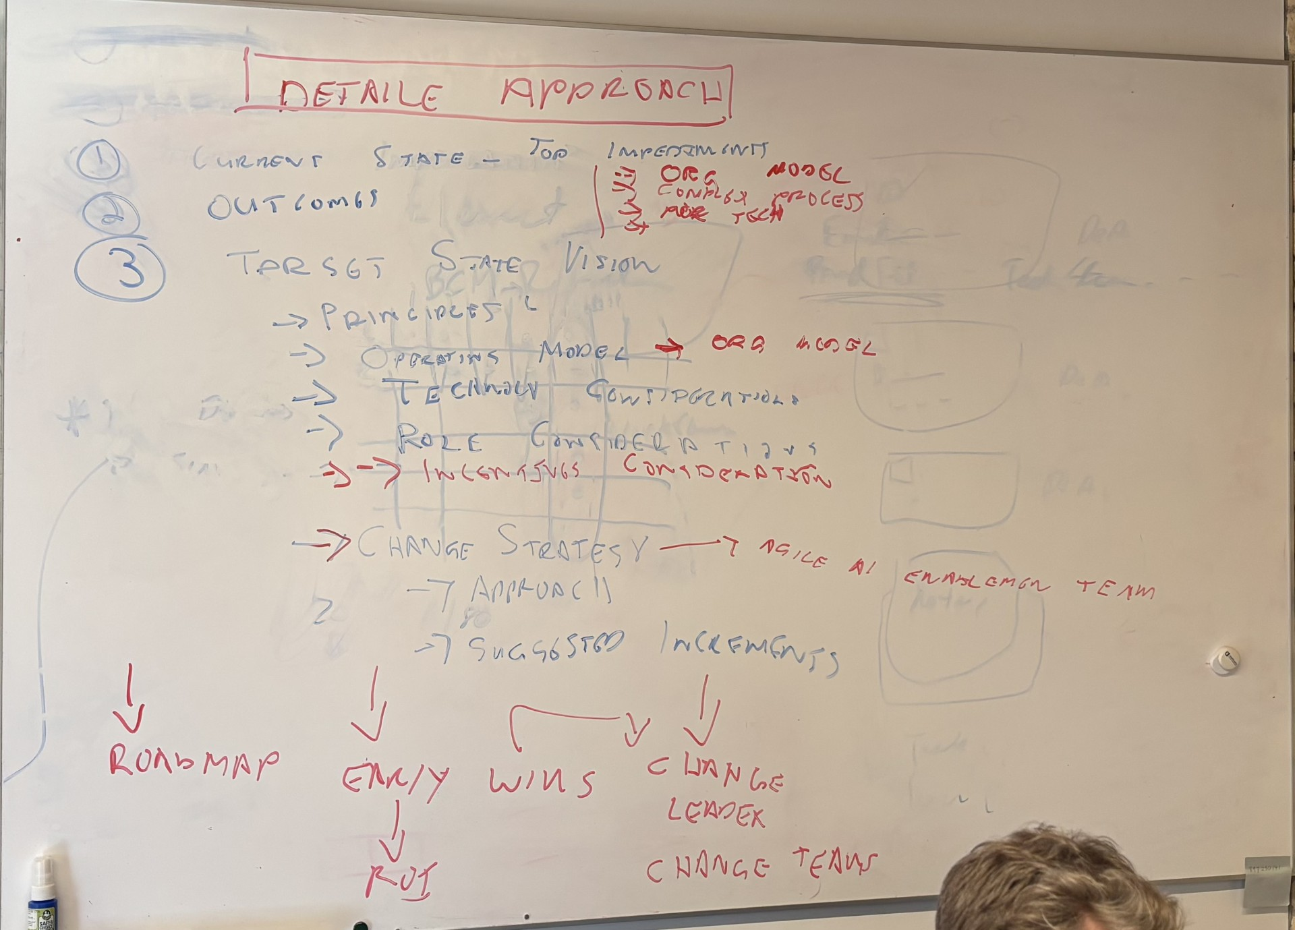
Evolve your system of work through achieving tangible business outcomes
Incrementally Shift toward an AI enabled Operating Culture
Behaviors that enable the change
Notes:
Building cross-functional teams and decentralizing decision-making encourages people to think and act more systemically, success is no longer a zero-sum game
What really improves teamwork is working on the interactions between the parts, because that’s where the problem solving happens

